Slide 1
Web scraping in Python
2025-2026

Slide 2
Web scraping
Web scraping is the process of scraping information from websites
You convert the extracted data into a readable format that a programming language can easily work with.
This sounds rather silly, as you’re creating a database from a website that gets its content from an existing database
But if the creator of the database doesn’t give you access to the original database, you have to reverse-engineer it
It’s a bit of a cat chasing her tail:
a scrape only works as long as the website isn’t changed

Slide 3
Alternative to scraping: APIs
Some websites offer Application Programmable Interfaces that allow you to access their data using a format like JSON.
Using an API is more stable and reliable because when the front-end of a website changes, it affects your scraping code while the back-end API structure usually remains unchanged.

Slide 4


Web scraping demo from course on Real Python
https://realpython.com/beautiful-soup-web-scraper-python/

Slide 5
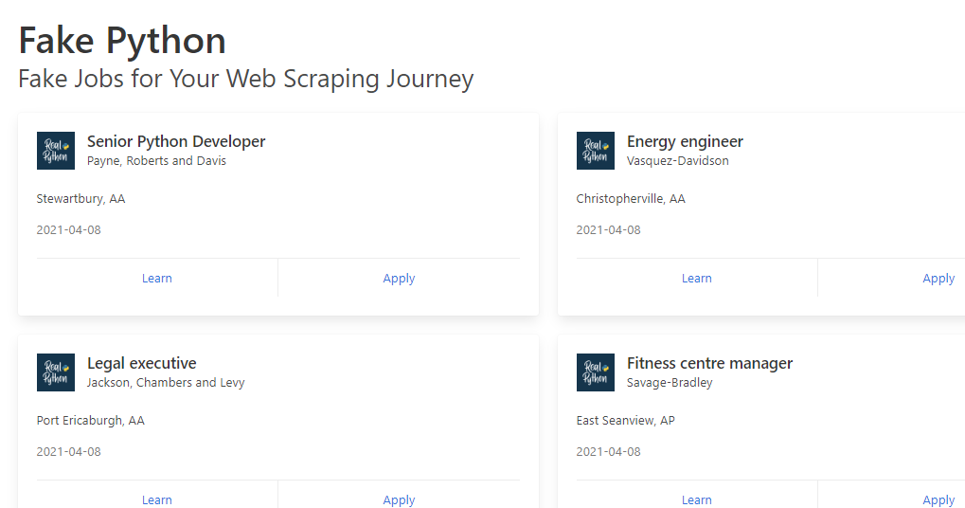
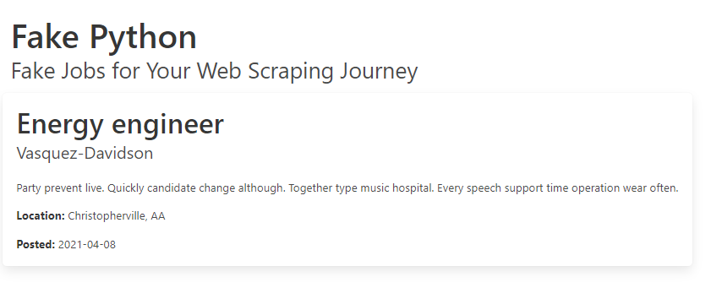
Web scraping demo from course on Real Python
Goal: scrape the data from a fake jobs advertising site
https://realpython.github.io/fake-jobs/

Slide 6
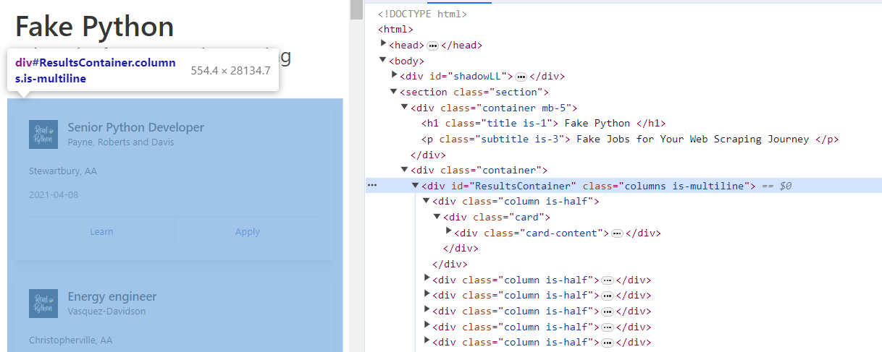
Web scraping demo from course on Real Python
Step 1:
Inspect the site’s url(s) and used query parameters
Inspect the site’s DOM (document object model)

Slide 7
Web scraping demo from course on Real Python
Step 2:
Load the returned HTML code from a specific url into your script using Python’s requests library.
Install the library in your venv first: pip install requests
# demo scraping static site
import requests
URL = https://realpython.github.io/fake-jobs/
# execute HTTP GET request to retrieve the sent HMTL data
page = requests.get(URL)
print(page.text)

Slide 8
Web scraping demo from course on Real Python
Step 3:
Filter the response from step 2 to the data you need using the Python library Beautiful Soup.
Install the library in your venv first: pip install beautifulsoup4
Parse the response into html-format
import requests
from bs4 import BeautifulSoup
URL = "https://realpython.github.io/fake-jobs/"
page = requests.get(URL)
# parse html via bs4
# use page.content instead of page.text to avoid character encoding issues
soup = BeautifulSoup(page.content, "html.parser")

Slide 9
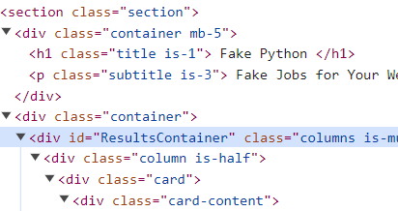
Web scraping demo from course on Real Python
Step 3:
Find the element you need by using the assigned id attribute
Result is a filtered part of the entire html soup
soup = BeautifulSoup(page.content, "html.parser")
# prettify() pretty prints the html
results = soup.find(id="ResultsContainer")
print(results.prettify())

Slide 10
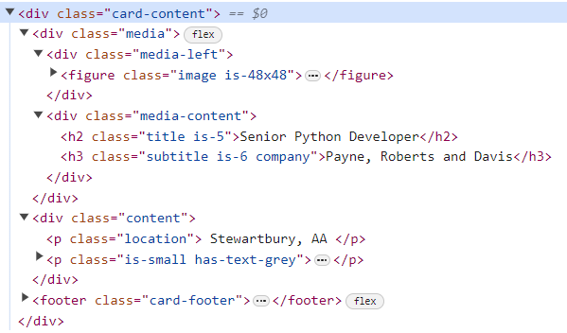
Web scraping demo from course on Real Python
Step 3:
Find the elements (find_all()) you need by using the HTML class name
Result is an iterable part of the entire html soup
soup = BeautifulSoup(page.content, "html.parser")
# more useful result: iterable
cards = soup.find_all("div", class_='card-content')
for card in cards:
print(card.prettify())

Slide 11
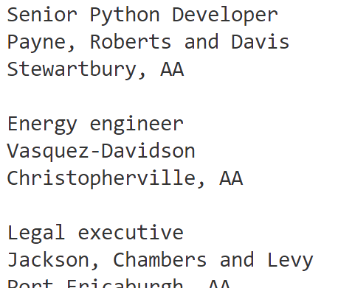
Web scraping demo from course on Real Python
Step 4:
Filter the information you need out of each card using find()
cards = soup.find_all("div", class_='card-content')
for card in cards:
title_element = card.find("h2", class_="title")
company_element = card.find("h3", class_="company")
location_element = card.find("p", class_="location")
print(title_element.text)
print(company_element.text)
print(location_element.text.strip())
print()

Slide 12
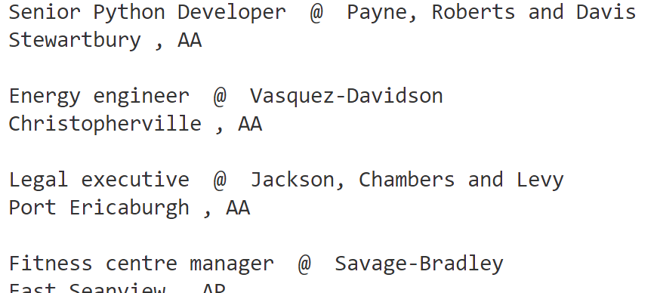
Web scraping demo from course on Real Python
Step 4 bis:
Use Regex to filter the information you need out of each card
import re
… cards = soup.find_all("div", class_='card-content’)
for card in cards:
job = re.search(r'-5">(.+)</h2>', str(card))
company = re.search(r'y">(.+)</h3>', str(card))
location = re.search(r'ion">\s(.+),\s(.+)',str(card))
print(job.group(1), ' @ ', company.group(1))
print (location.group(1).strip(),',',location.group(2))
print()

Slide 13
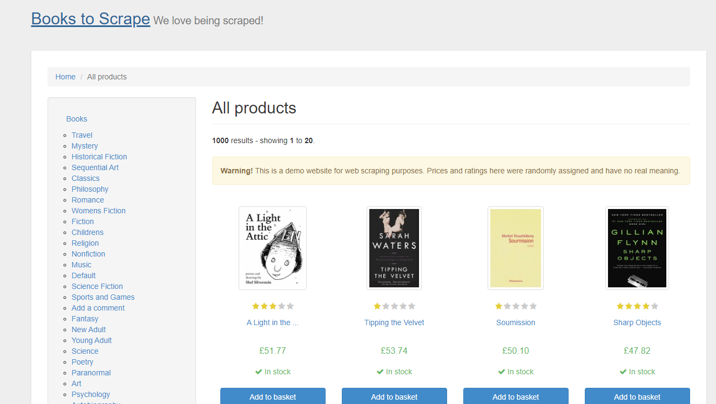
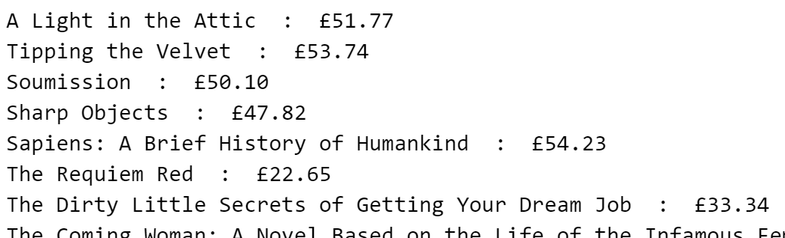
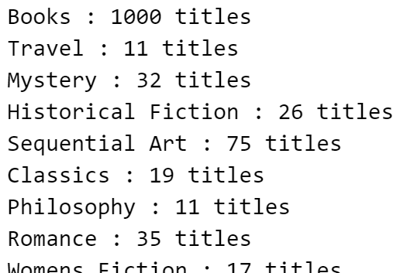
Time to practice
Exercise scraping books from the site books.toscrape.com
Exercise result after part 3:
Exercise result after part 4:

Slide 14
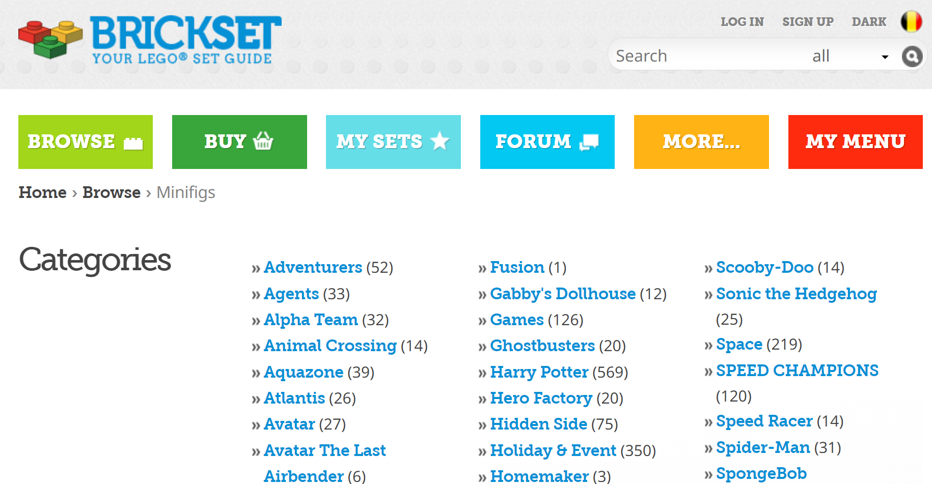

Time to practice
Exercise scraping the list of minifigs from the Brickset site

